Slide 1

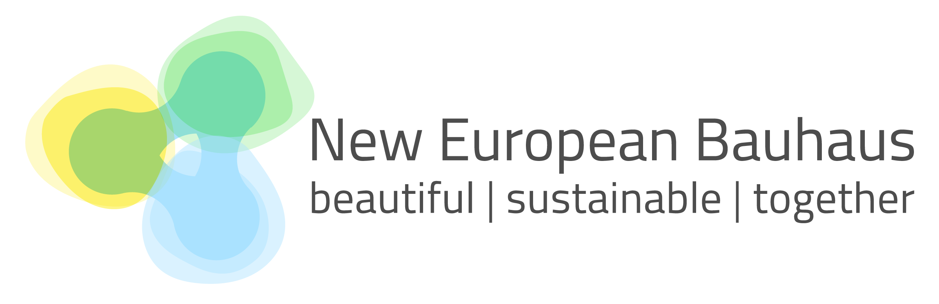

Slide 2
What is the NEB?
It is an initiative launched by the European Commission in 2020
It was inspired by the multidisciplinary, collaborative, and holistic approach of the Bauhaus movement of the early 20th century
It brings the European Green Deal to our daily lives reimagining how we design cities, buildings, public spaces, and communities

Slide 3
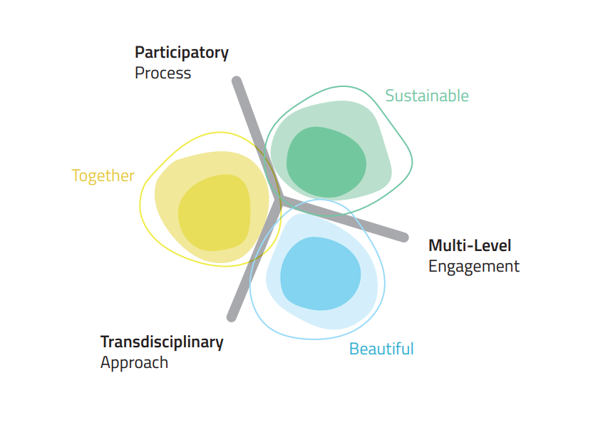
NEB Values and Working Principles
NEB Values
Sustainability
Aesthetics
Inclusion
NEB Principles
Participatory
Transdisciplinary
Multi-level

Slide 4
Why do we want/need the NEB?
Create opportunities for green jobs, support local craftsmanship, and strengthens Europe’s position as a leader in sustainable innovation.
Adaptive reuse of old industrial sites or historical buildings, turning them into cultural centres, co-working spaces, or affordable housing
Increase the quality of our projects by jointly addressing the dimensions of aesthetics, inclusiveness, and sustainability
Help foster local identity, pride, and cohesion, especially in neglected or underserved areas.
Put citizens and communities at the center of transformation ensuring so no one is left behind in the green transition.
Solutions that bring nature back into cities, making them greener and more sustainable

Slide 5
Cohesion Policy and the New European Bauhaus
Cohesion Policy is one of / a key driver for the NEB implementation: all 27 Member States have committed to the NEB, including references in at least 1 cohesion policy programme (including Interreg)
Over EUR 600 million allocated in cohesion policy programmes for the period of 2021-2027 supporting NEB initiatives across Europe (e.g. sustainable urban development, including town centre redevelopment, cultural heritage renovation, and green infrastructure improvement)
In addition, EUR 65 million ERDF to implement NEB 14 projects in 14 municipalities, and in the past, we already contributed to project preparation of 20 small and medium sized municipalities across the EU
NEB Community of Practice: Facilitate best practice exchanges on the NEB among Managing Authorities and encourage further investments under the 2021-2027 Cohesion Policy
Inclusion of the NEB either in Partnership Agreements
and Programmes
And
Programmes

Slide 6
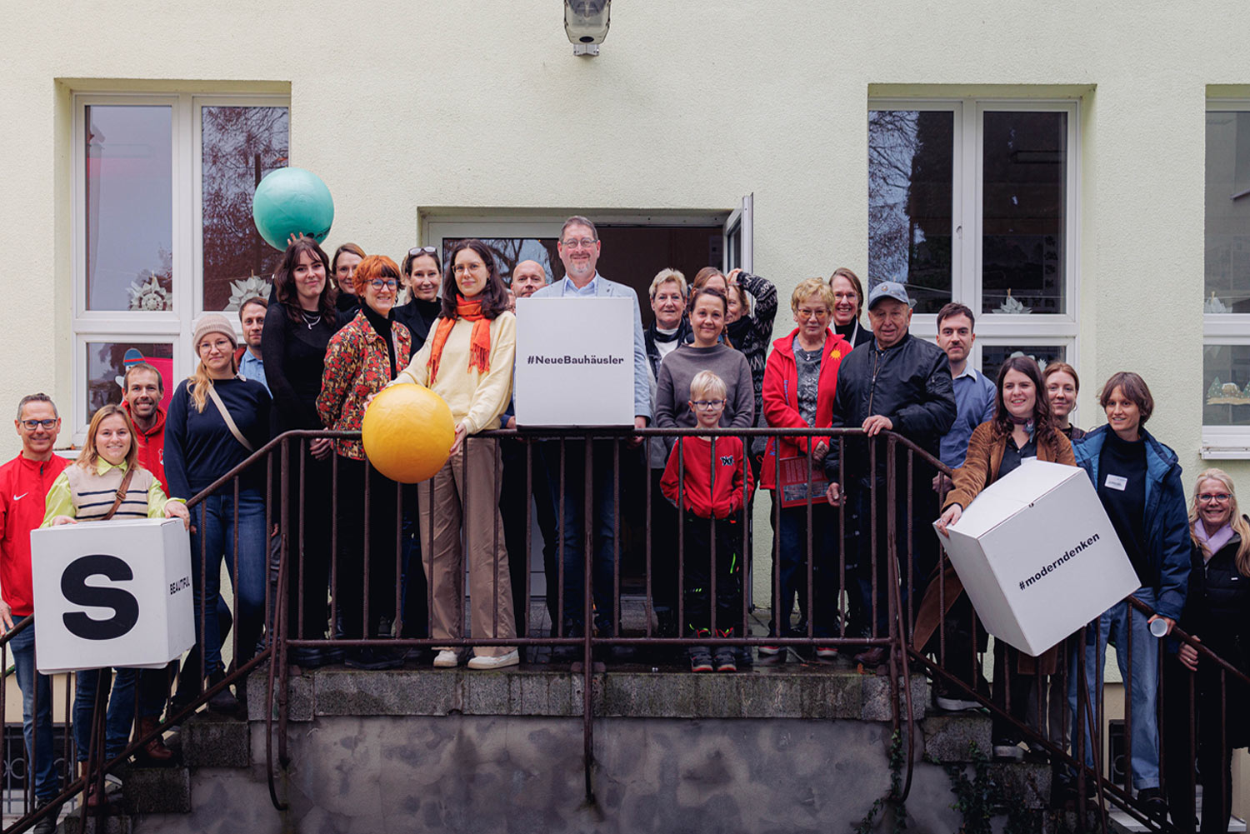
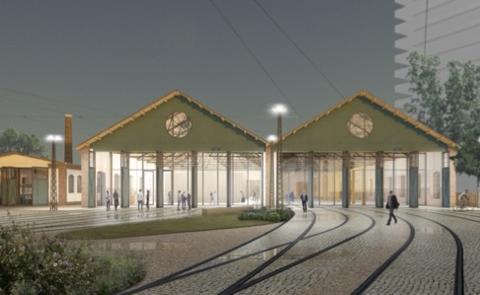
Examples of NEB Mainstreaming in cohesion policy programmes
St Finian's Seminary Study Hall, Navan, Co Meath
Community Center Kleinpaschleben
MultipleXity – Timișoara
THRIVE – Town Centre First Heritage Revival Scheme (Ireland)
EUR 54.5 million ERDF
Revitalising derelict buildings in town centers in line with the values of the New European Bauhaus
Saxony-Anhalt (Germany)
EUR 38 million JTF
The New European Bauhaus will contribute to the green, social and urban transformation of the mining region of Saxony-Anhalt.
West Region (Romania)
EUR 23.8 million ERDF
Target support for revitalisation and transformation of urban spaces and buildings in line with the New European Bauhaus
And
Programmes
And
Programmes

Slide 7
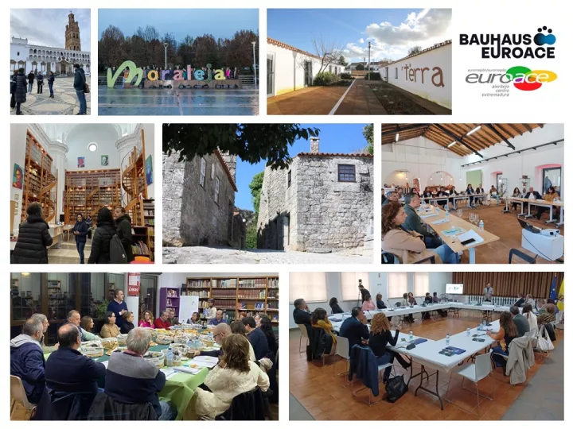
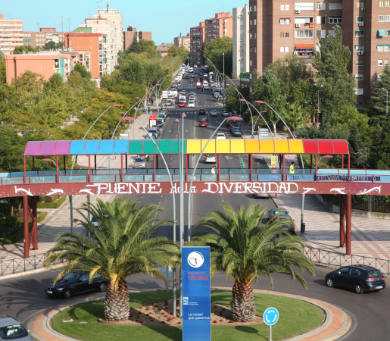
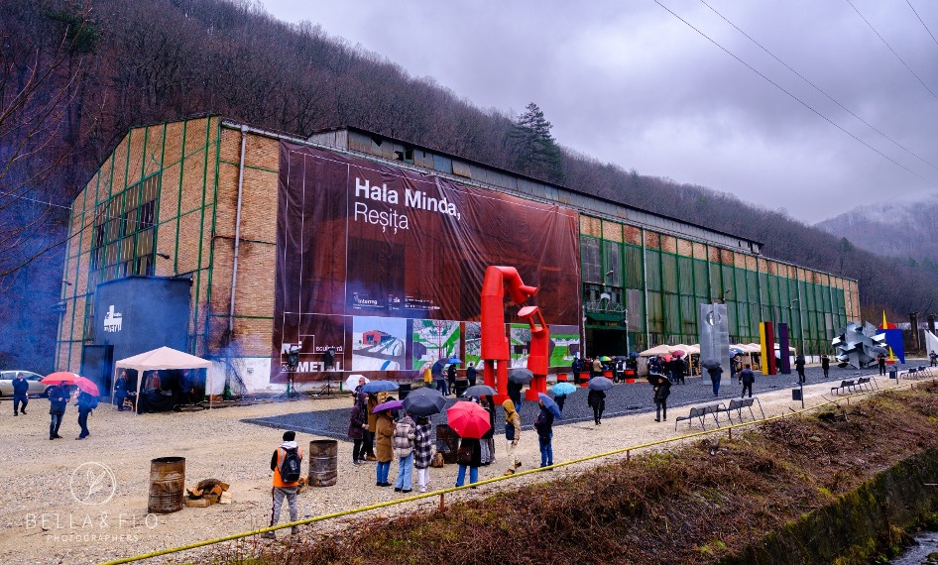
NEB projects supported by cohesion policy
Network of villages for the Future (received direct support for project preparation)
Portugal/Spain (6 villages)
It defines a new policy mix for six villages (PT, ES), with interventions on environment, public spaces and business environment, to foster attractiveness of rural spaces.
SHARE - Sustainable Housing Accommodation for a Regenerative Exchange (selected in the EUI-IA call)
Fuenlabrada, Spain
Revitalizes through sustainable, intergenerational living for seniors and youth, tackling urban decay via resource reuse and community collaboration.
Hala Minda (received direct support for project preparation)
Reșița, Romania
Reconverts a former industrial site into a multifunctional centre for the communities and creative industries – equipped with state-of-the-art technologies for metal processing

Slide 8
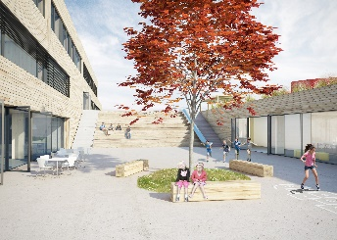
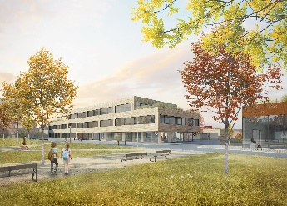
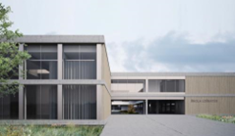
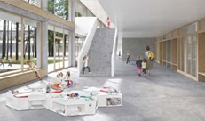
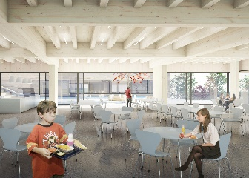
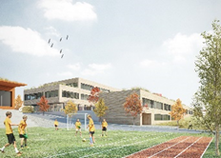
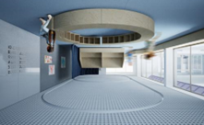
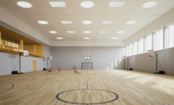
NEB projects supported by cohesion policy in Czechia
Základní škola Říčany
PŽP 2021-2027
https://www.rusinafrei.cz/project/zakladni-skola-ricany/
Svazková základní škola (Louňovice, Štíhlice, Tehovec, Svojetice)
PŽP 2021-2027
https://www.losbates.cz/o-projektu/architektonicka-soutez/1-cena-1/

Slide 9


NEB in Czechia (and Slovakia)
NEW EUROPEAN BAUHAUS - New European Bauhaus in Slovakia and the Czech Republic in 2023 in Brno
Conference on Energy Efficiency and Renewable Energy Sources financed from EU Cohesion Policy Funds With Focus on Slovakia and Czechia
UPCOMING! 17 June 2025 Bratislava
Seminář Energetická efektivita a obnovitelné zdroje energie - SFŽP ČR
Konferencia: Energetická efektivita a obnoviteľné zdroje energie financované z kohéznych fondov EÚ - SIEA

Slide 10
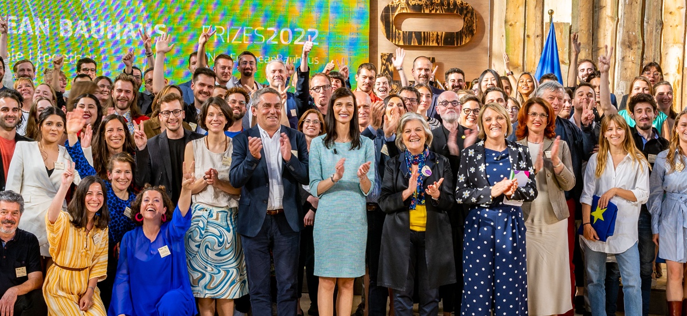
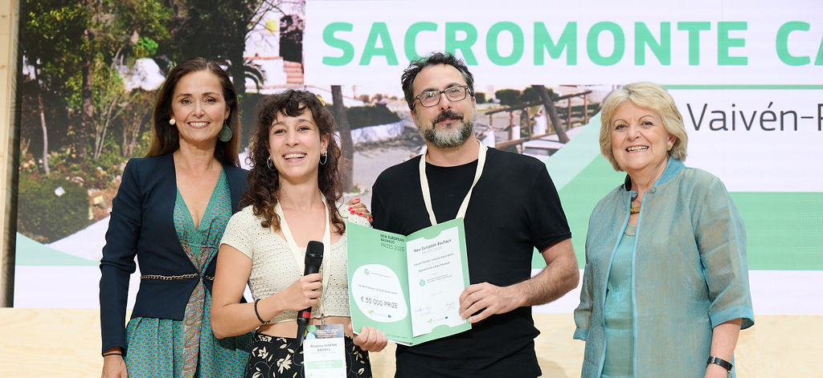
In parallel, NEB Prizes
Inspire change, elevate impactful initiatives, and provide visibility to those working to transform communities
Over 5500 applications received across five editions (2021-2025)
EUR 2 million in awards to 94 winners by the end of the NEB Prizes 2025
In 2025, a total of EUR 600 million will be awarded to 20 small municipalities (NEB Boost for Small Municipalities)

Slide 11
How to join the NEB community and access its resources
Join the official NEB Community to learn more about funding opportunities. This community is open to public and private organizations promoting the core values of the New European Bauhaus.
Join the dedicated NEB Community of Practice supporting the NEB mainstreaming in cohesion policy by facilitating the exchange of best practices and knowledge among EU cohesion policy funds practitioners. This community is part of REGIO Peer2Peer Communities open for programming authorities of cohesion policy (e.g. managing authorities, intermediate bodies and local authorities).
Contact the NEB National Contact Point in your Member State to leaner more about the NEB initiative in your country: Nový evropský Bauhaus | mkcr.cz
Participate in the NEB Festival and NEB Prizes competition.

Slide 12
NEB tools and support
The NEB Compass: guiding framework for decision and project makers wishing to apply the NEB principles and criteria to their activities
The NEB Toolbox: practical tools, workshops, and good examples to project promoters on how to implement NEB values effectively
The NEB Mainstreaming Toolkit: scoring grid to help managing authorities with the selection and evaluation process of NEB project and potential beneficiaries to apply the NEB values in their initiatives
The NEB Investment Guidelines: practical guide on how and why investments in built environment projects can be aligned with the New European

Slide 13
Next steps of the NEB initiative
NEB remains a priority in the European Commission’s agenda.
Efforts to mainstream the NEB into cohesion policy will continue to drive sustainable, inclusive, and high-quality investments across Europe
The NEB Facility aims to revitalize neighbourhoods through design for sustainability and inclusion.
It combines different sources of funding featuring: a Research & Innovation Component with an indicative budget of EUR 120 million per year through Horizon Europe (2025-2027), and a Roll-out Component aiming for similar annual investment from EU programmes, with additional support from national and private funding.
Firsts calls for proposals under the R&I component of the NEB Facility have been published! DDL: 12/11/25

Slide 14
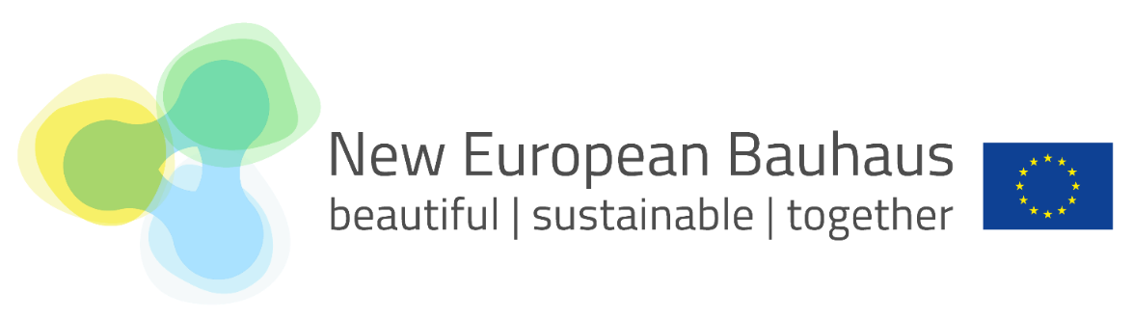
Thank you for your attention!
Directorate-General for Regional and Urban Policy
Unit F.4 'Czech Republic and Slovakia’
Katarina Hobzova

