Slide 1
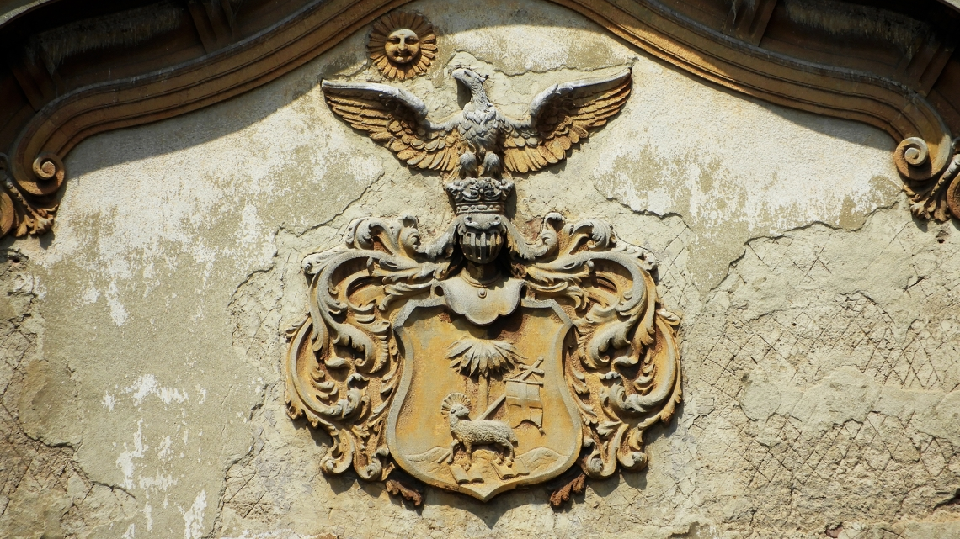
DEBRECEN
RE/BUILDing A CITY

Slide 2
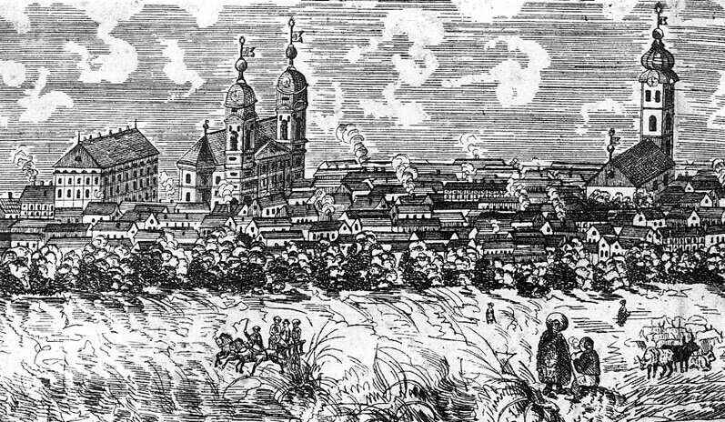
Sustainablity is our identity

Slide 3
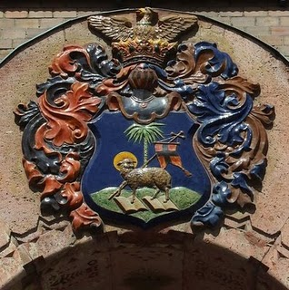
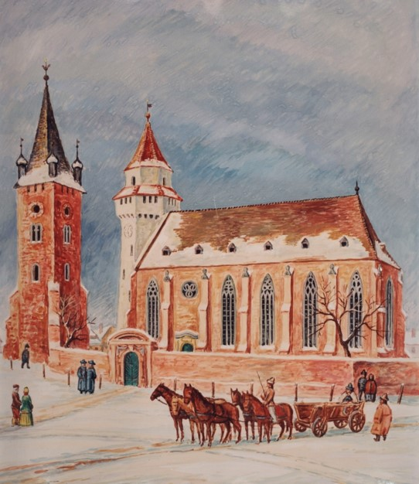
CÍVIS IDENTITY
COLLABORATIVE COMMUNITY
THE CITY AS A COMMON PURPOSE
STRONG SENSE OF AUTHONOMY AND SOVEREIGHNITY
EDUCATION
PROTESTANT CULTURE
CAPACITY OF RESILIENSE

Slide 4
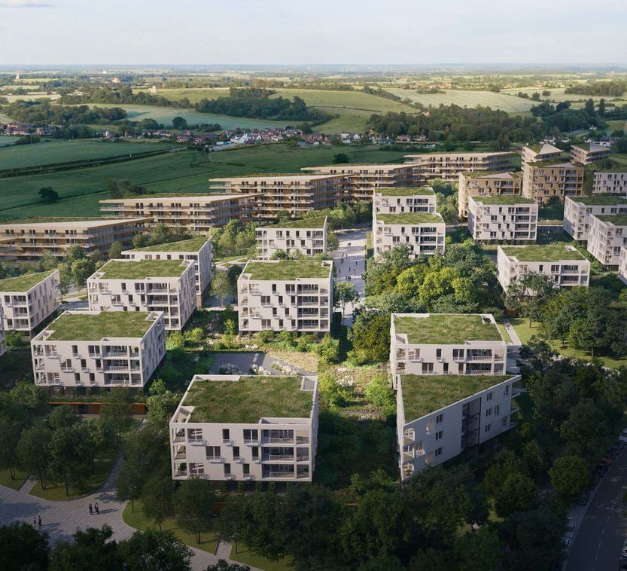
A city in transformation
D2030 Development Strategy
Sustainable City Development Strategic Plan
Green Codex
Cultural Strategy

Slide 5
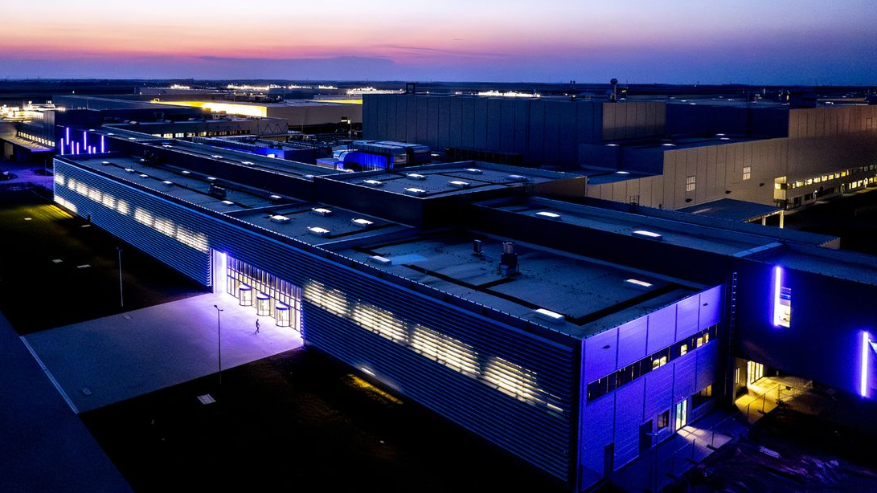
ELECTRIC MOBILITY HUB

Slide 6
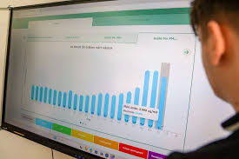
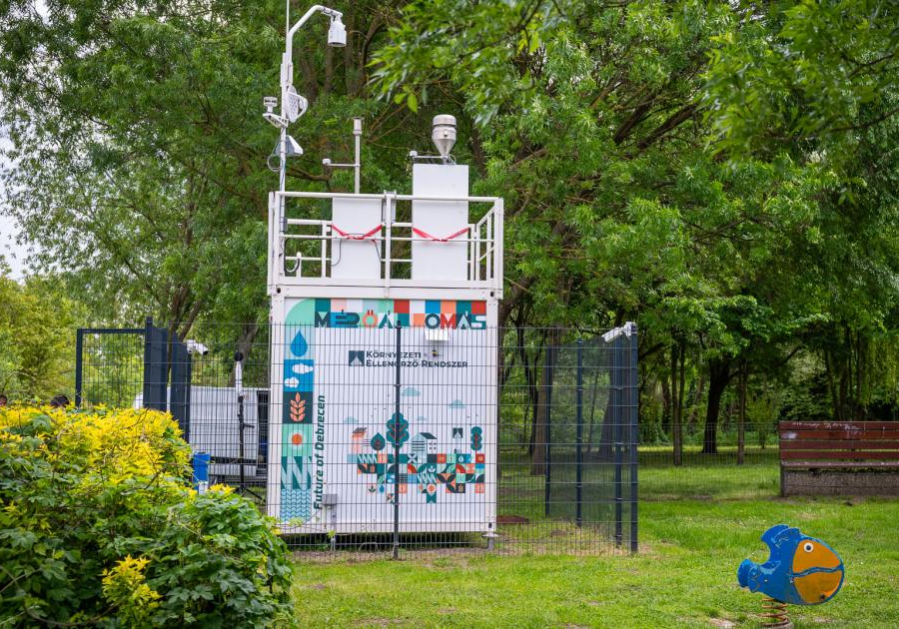
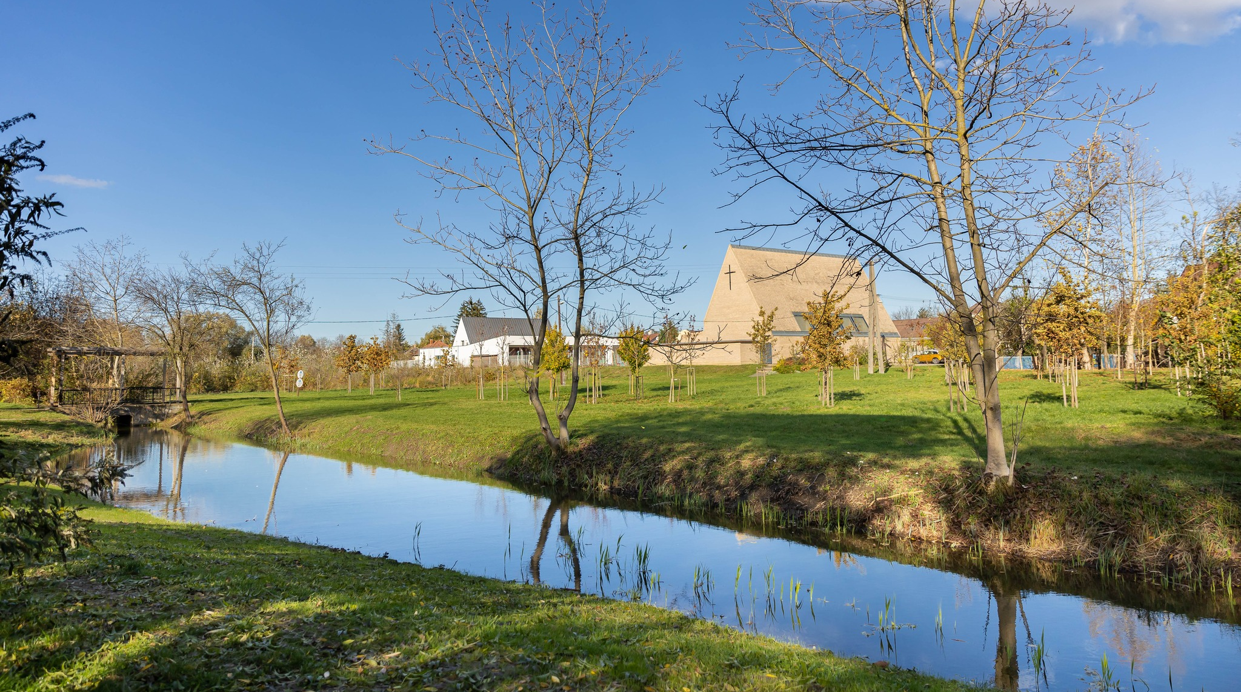
Sustainable development
GREEN SENTINEL
CIVAQUA

Slide 7
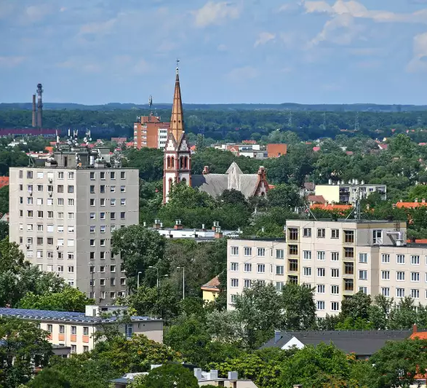
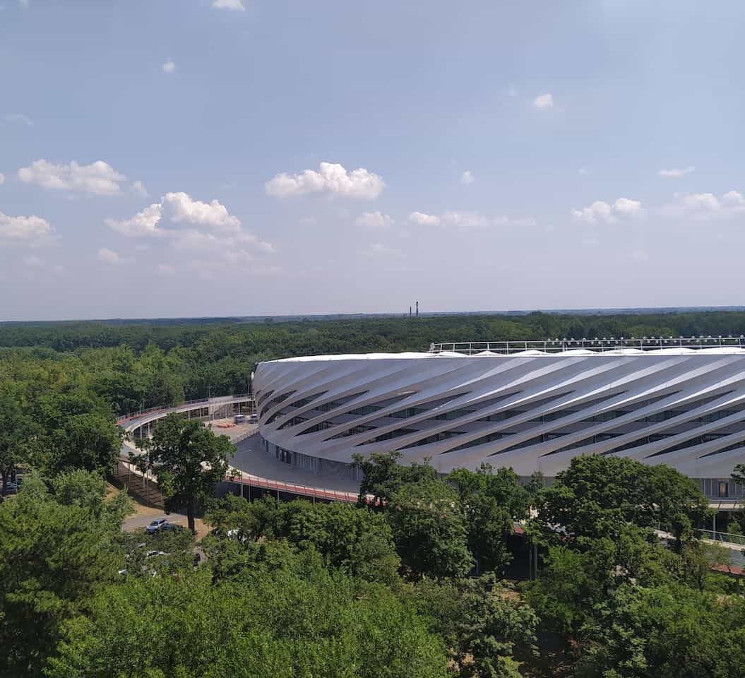
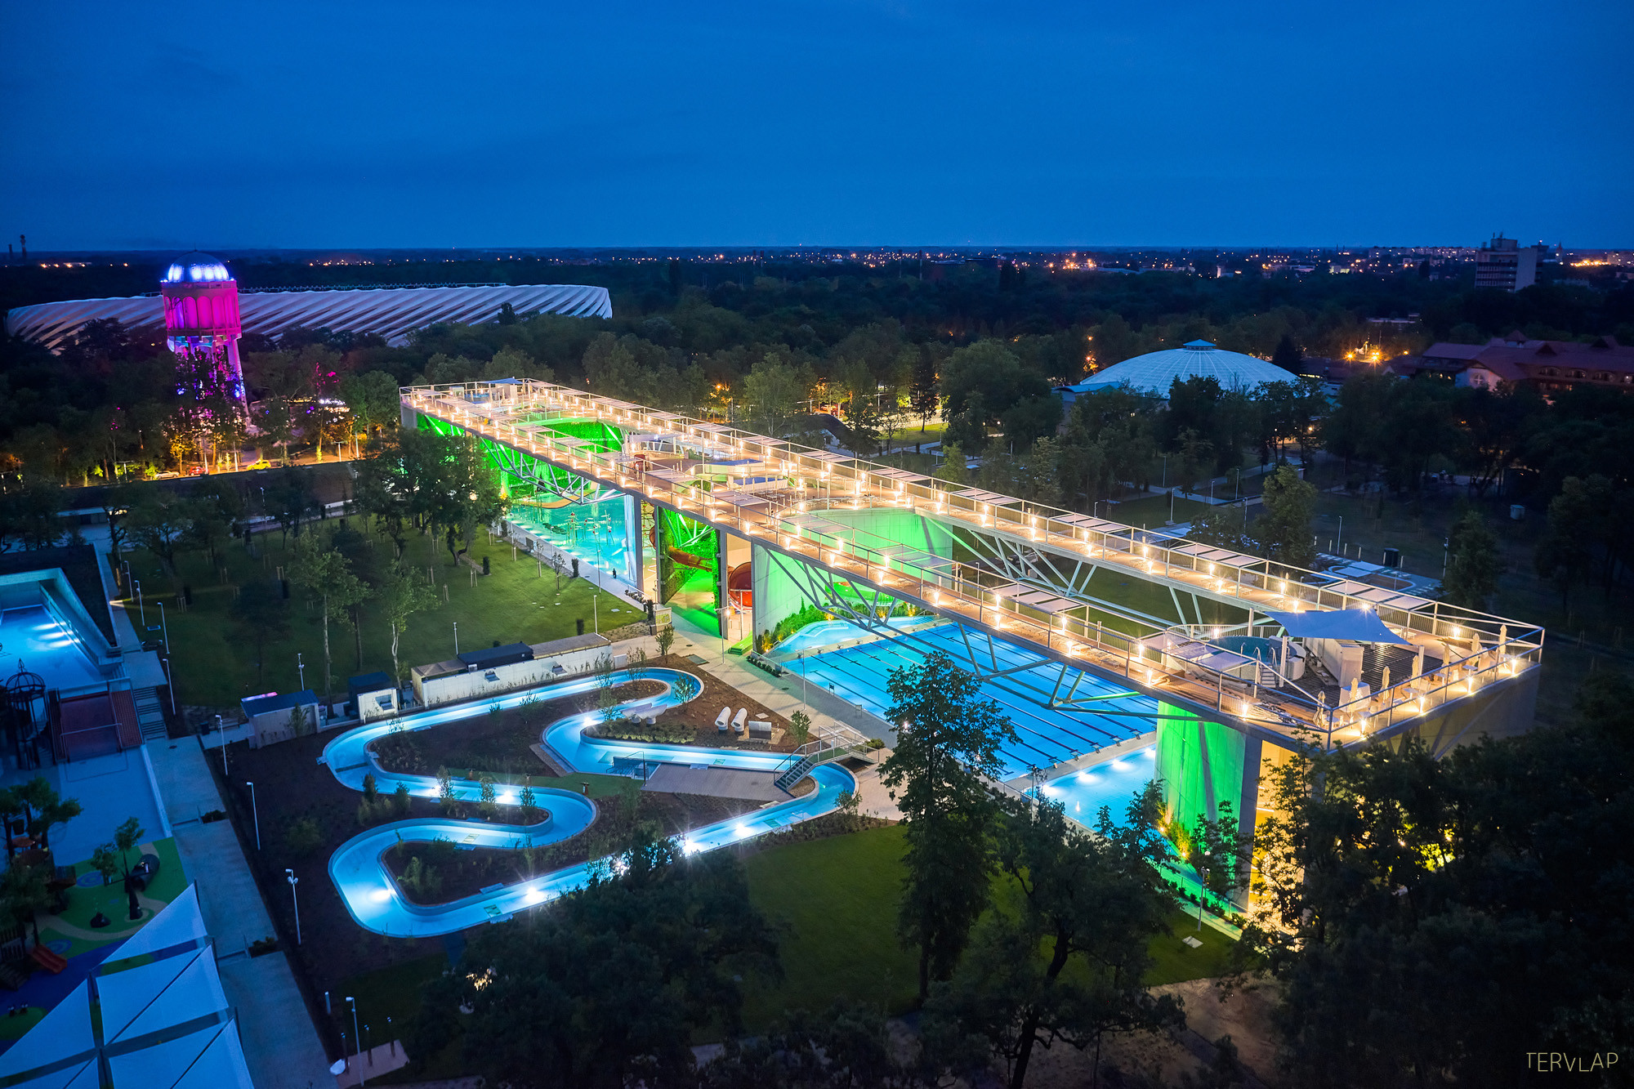
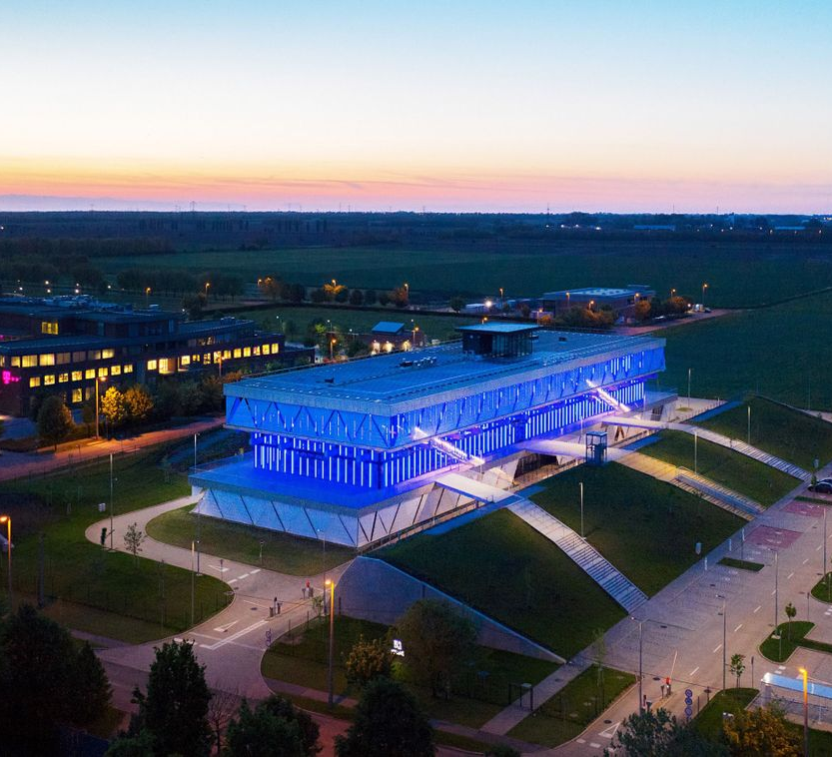
GREEN HERITAGE, GREEN FUTURE

Slide 8
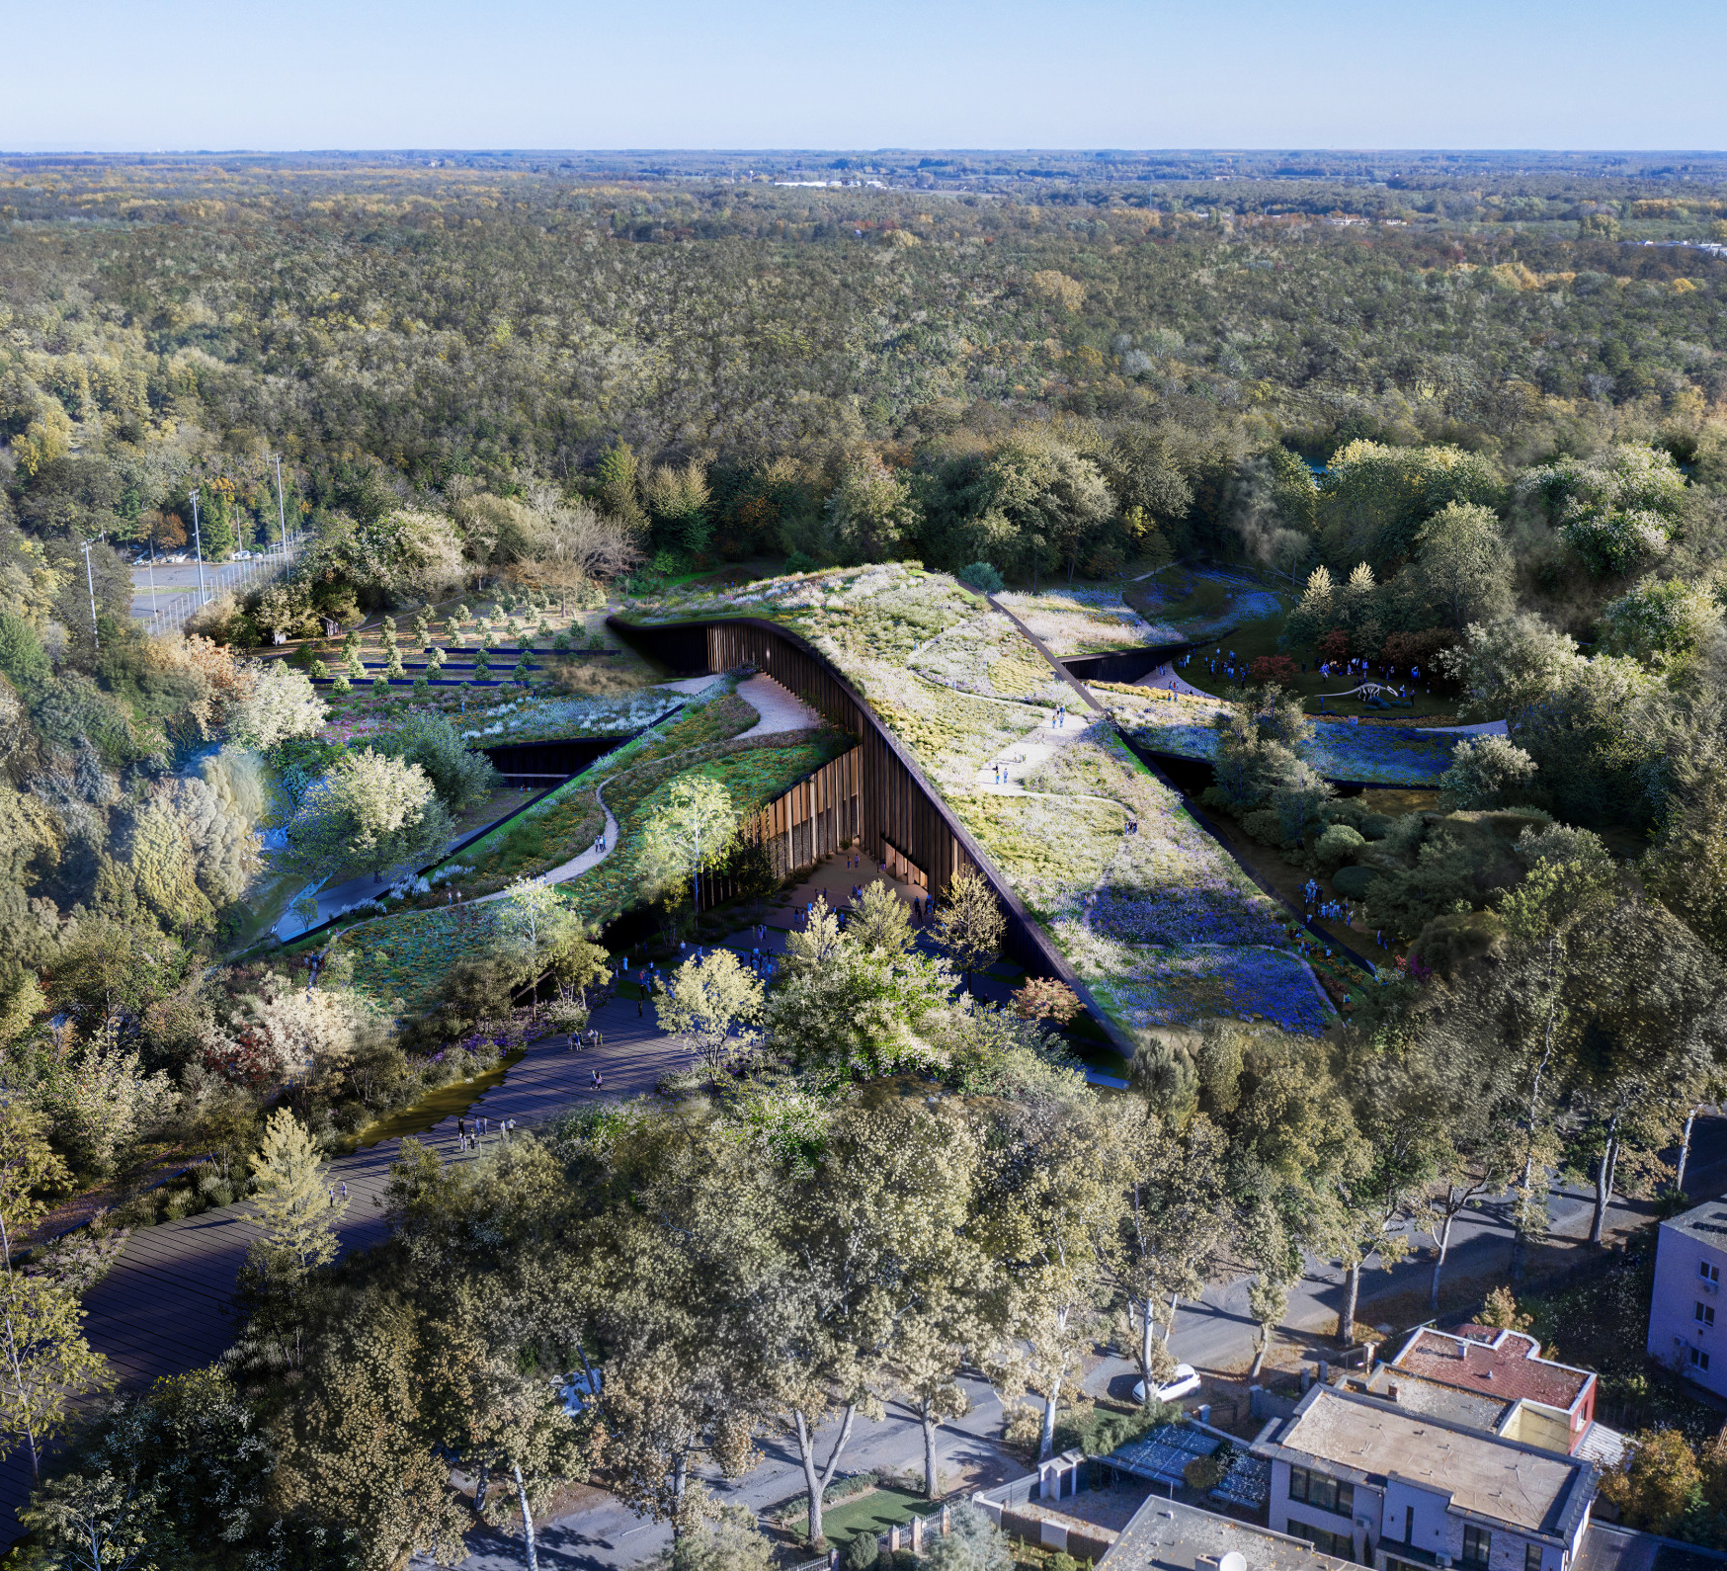
Build / rebuild

Slide 9
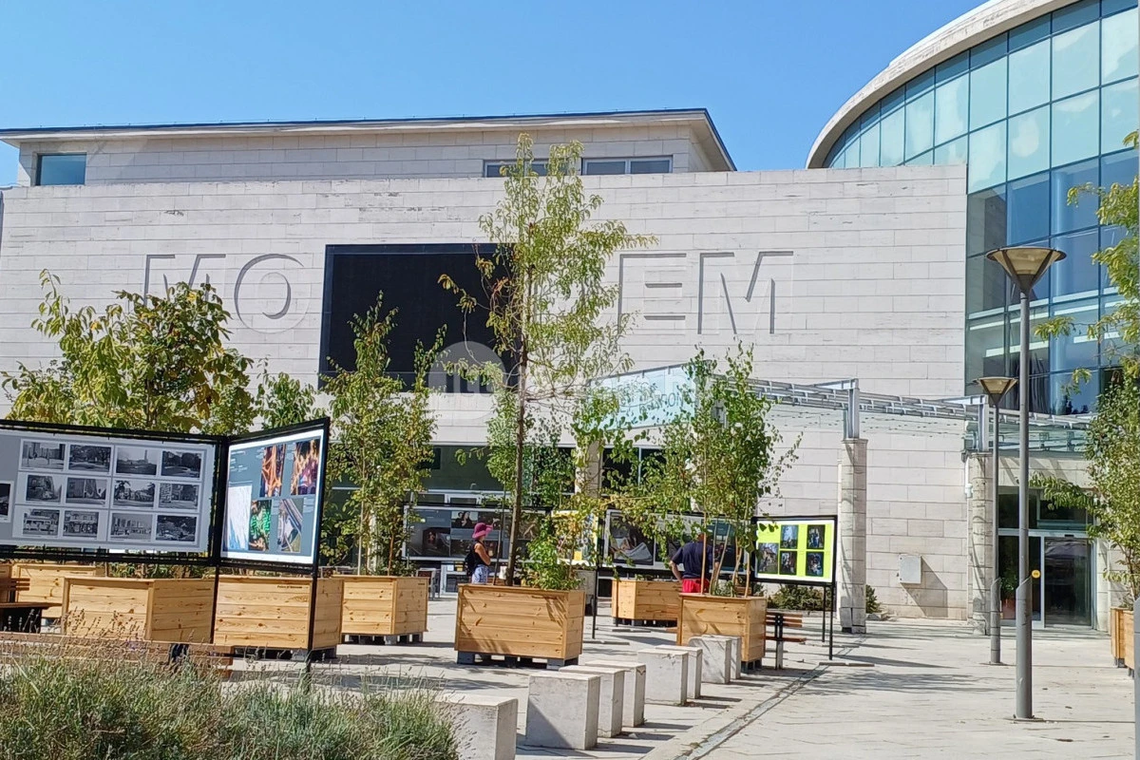
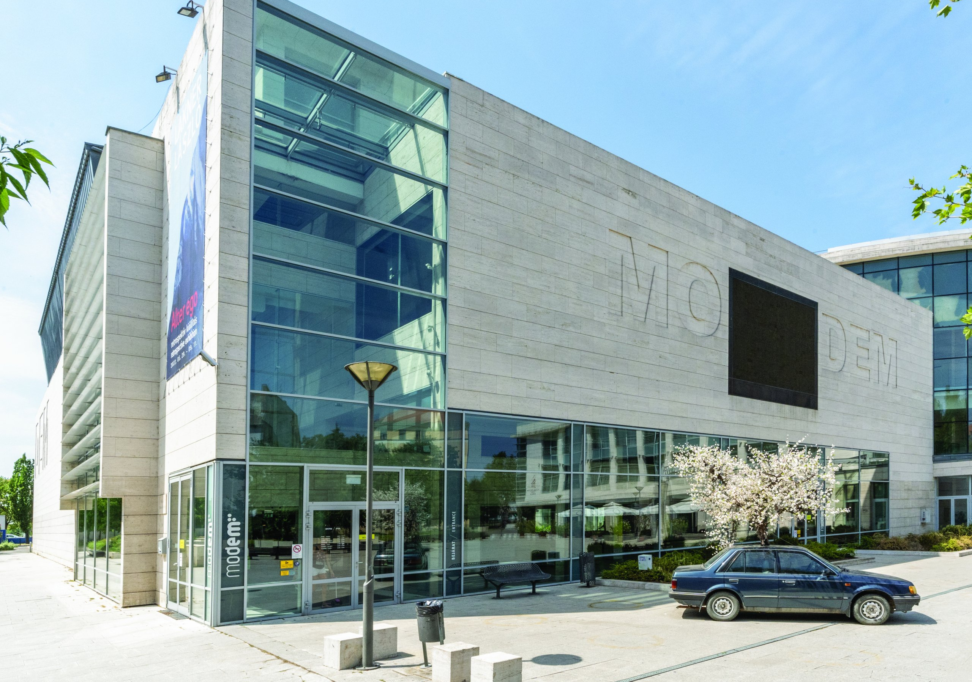
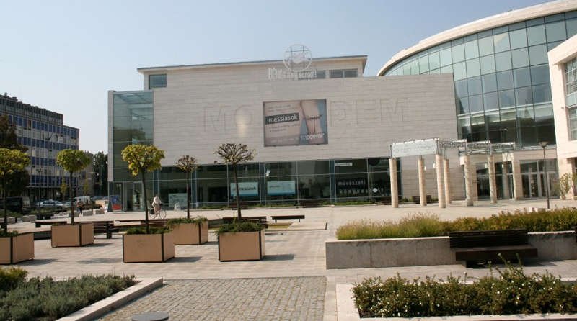
BUILD / REBUILD

Slide 10
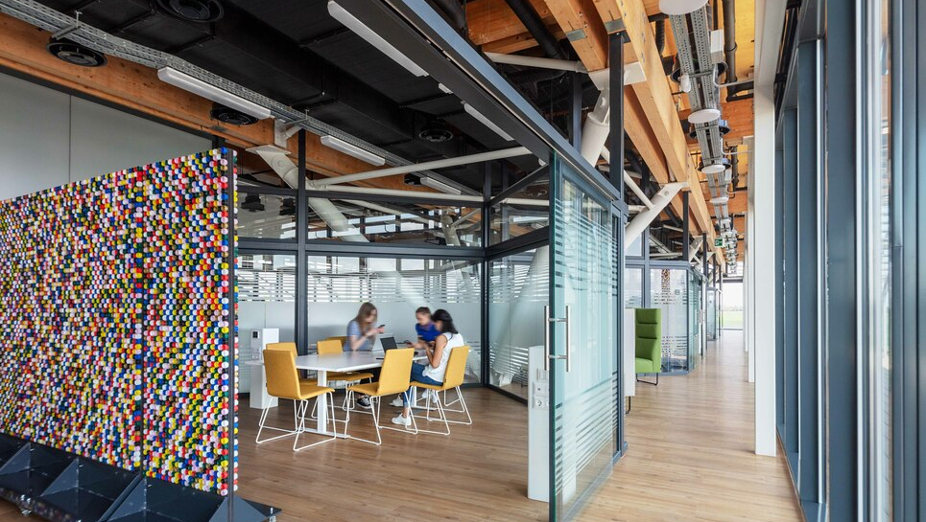
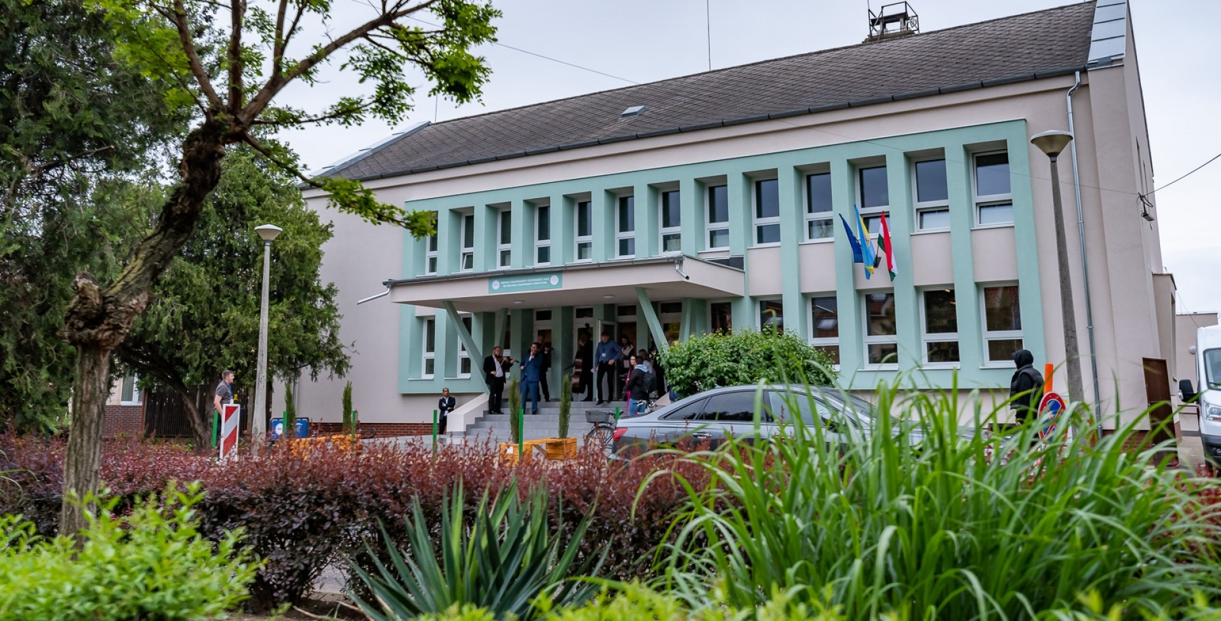
SUSTAINABLE COMMUNITIES

Slide 11
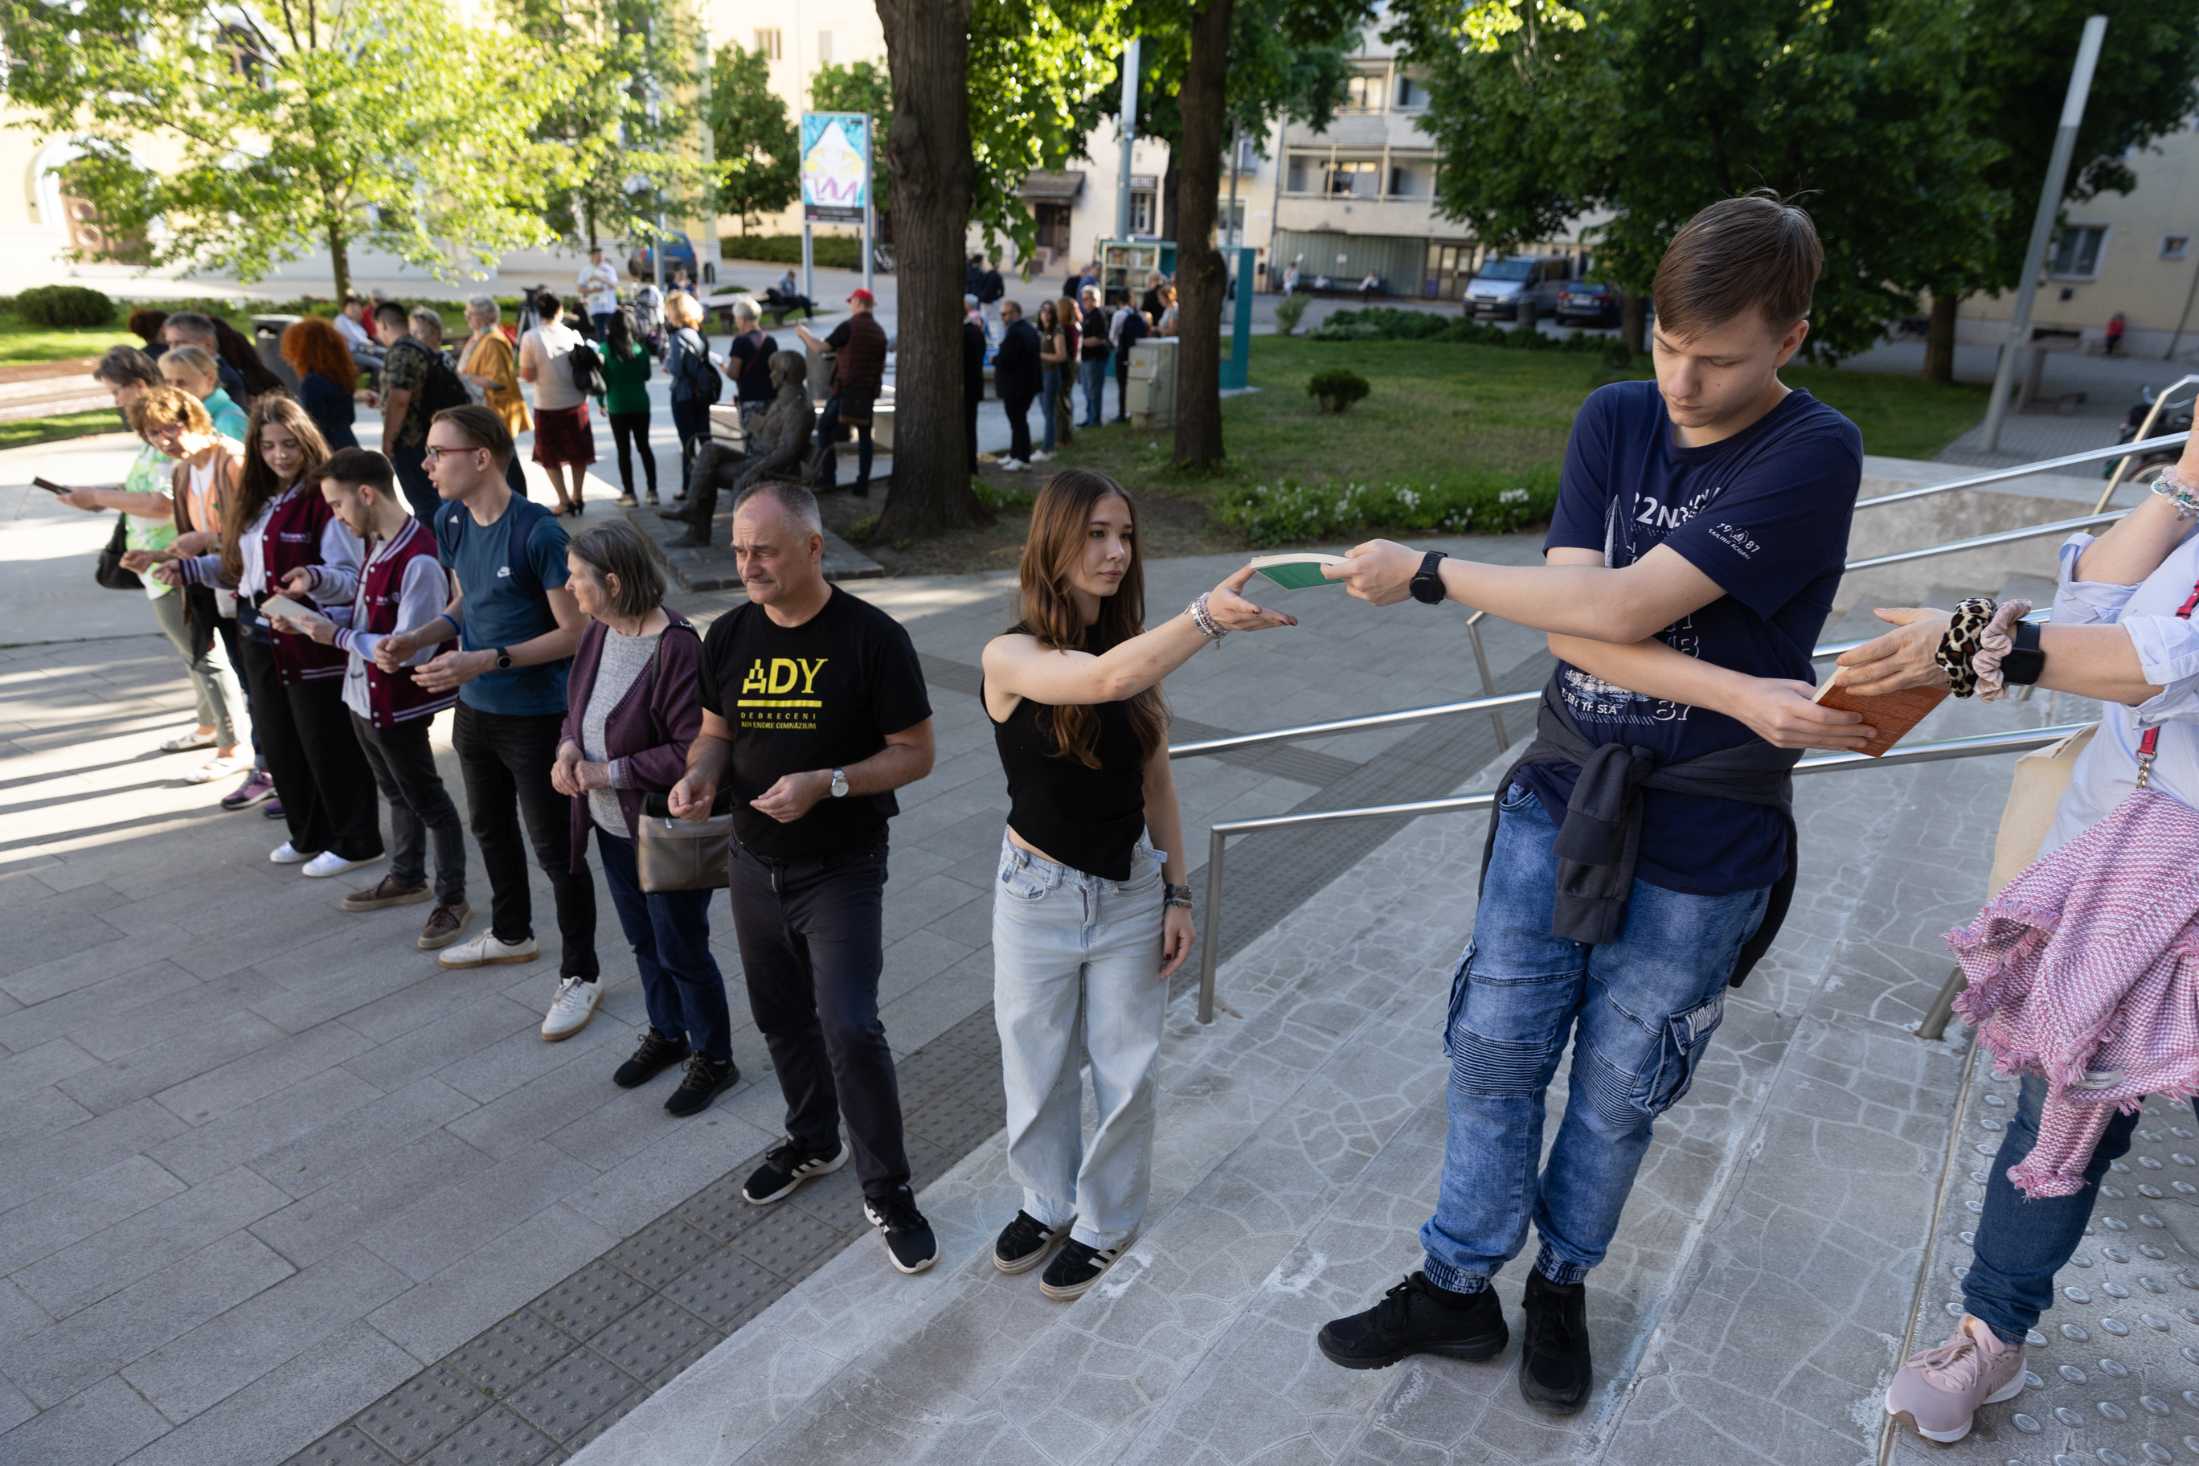
HOW WE ARE REBUILDING COLLABORATIVE COMUNITIES?
THE RULE OF THE MUNICIPALITY: MEDIATION
DIALOGING COMMUNITIES
CONCRETE PROJECTS
PARTICIPATION BUDGET

Slide 12
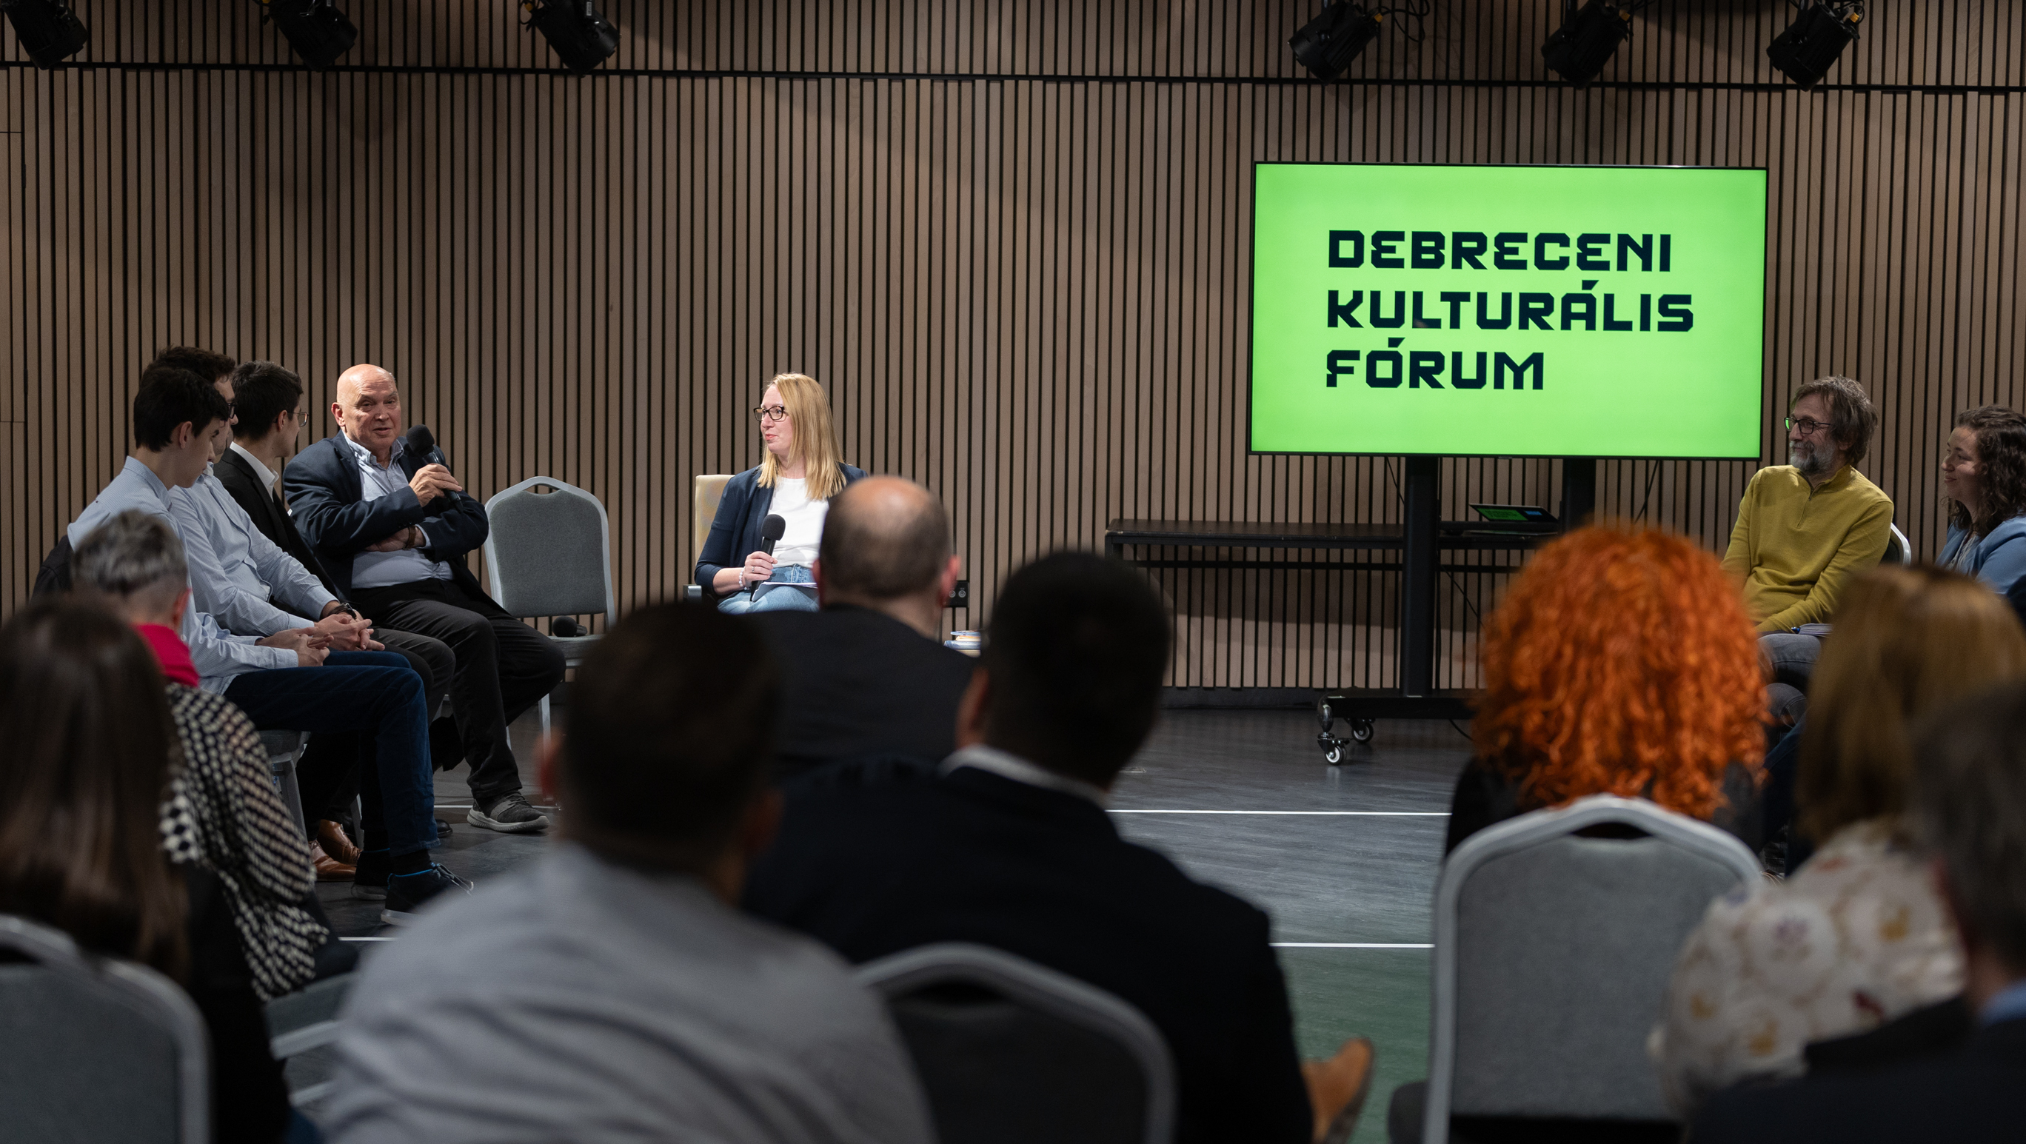
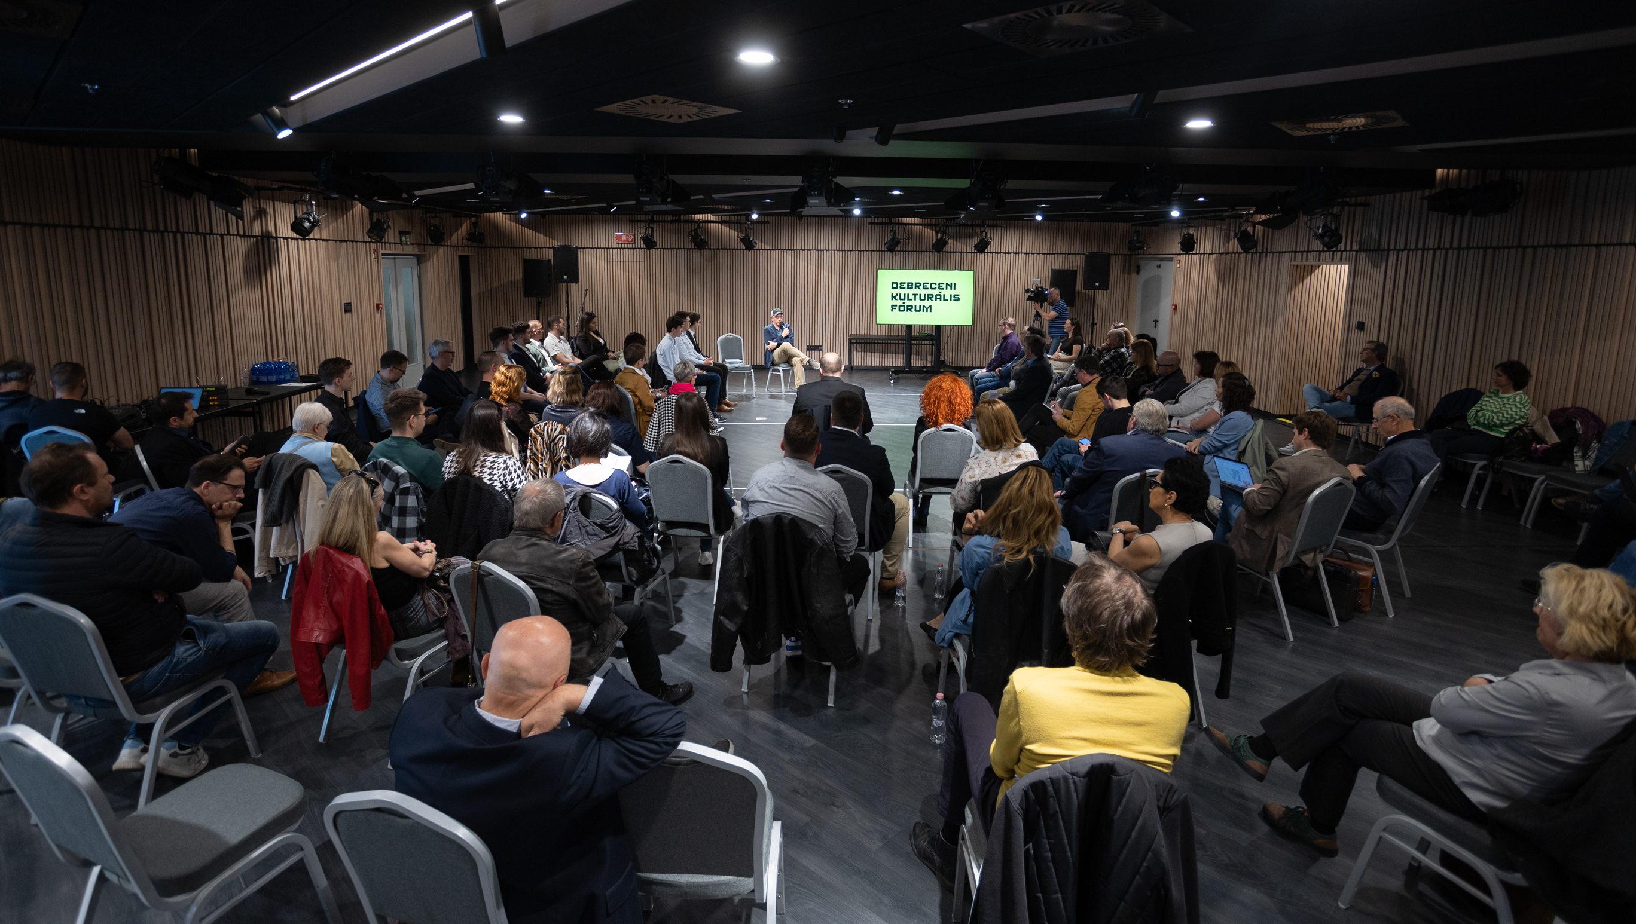
I. Debrecen cultural forum

Slide 13
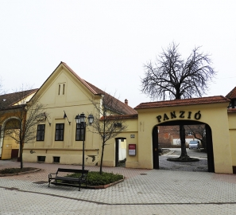
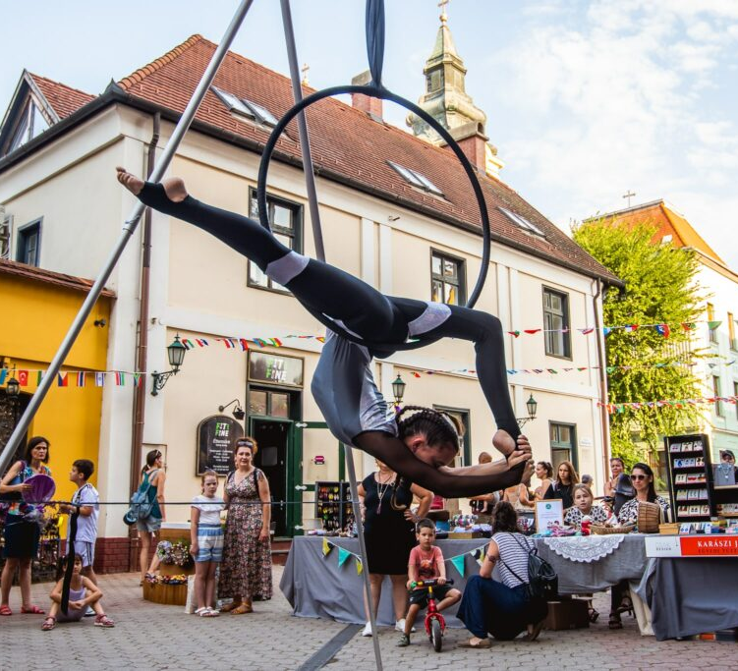
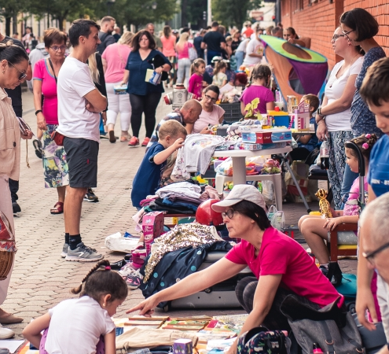
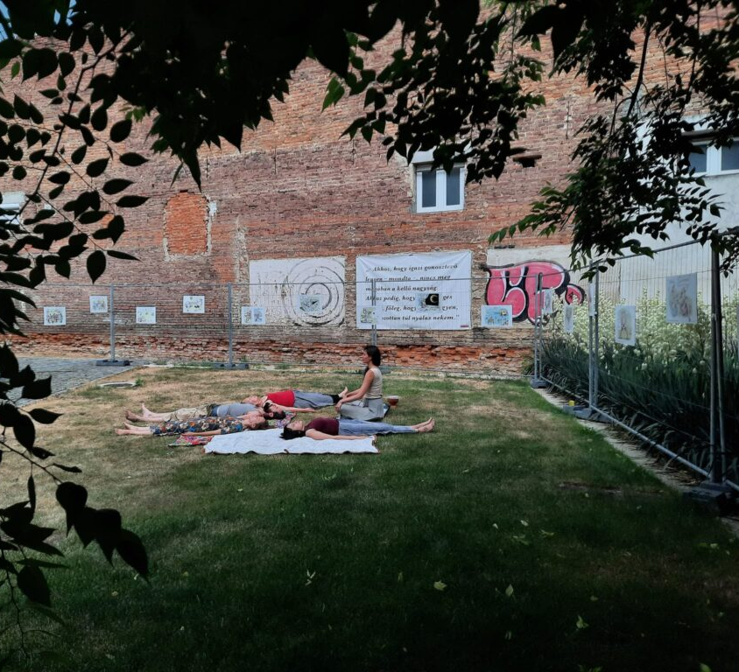
Sustainable collaborations

Slide 14
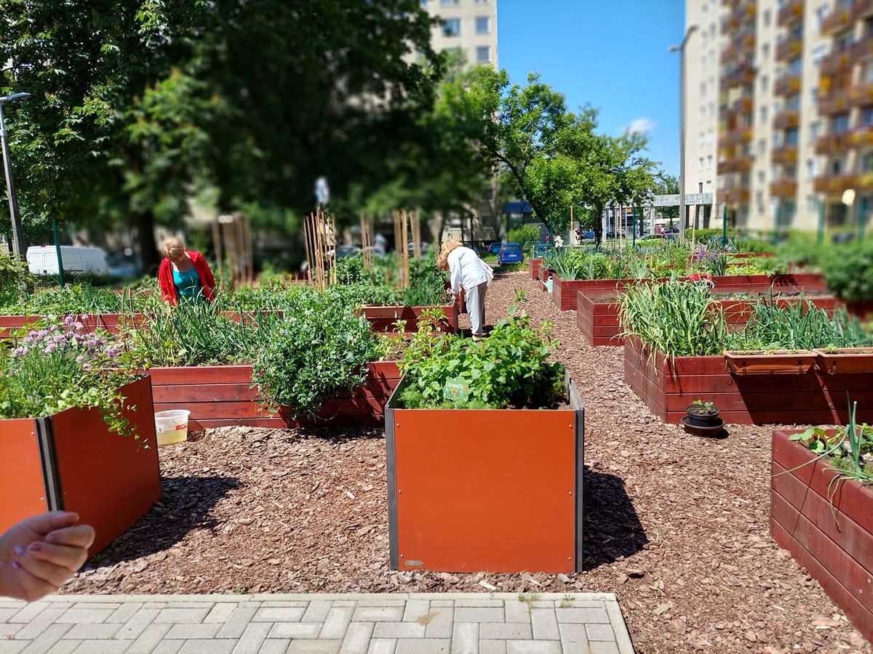
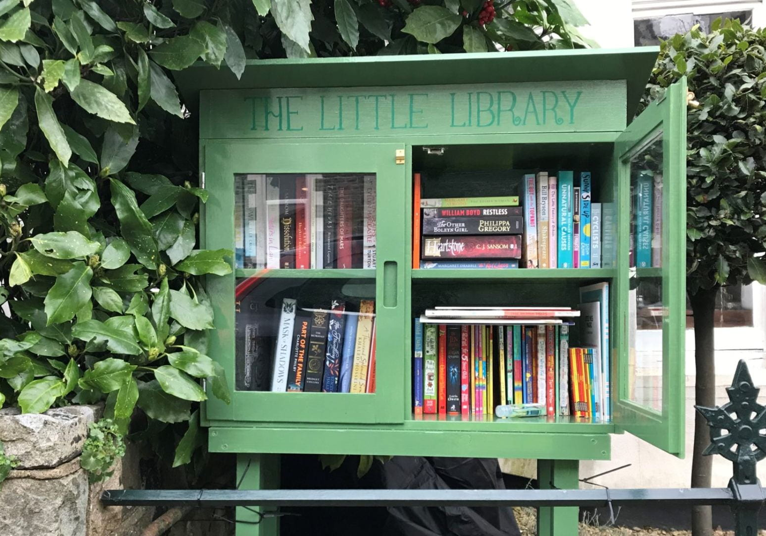
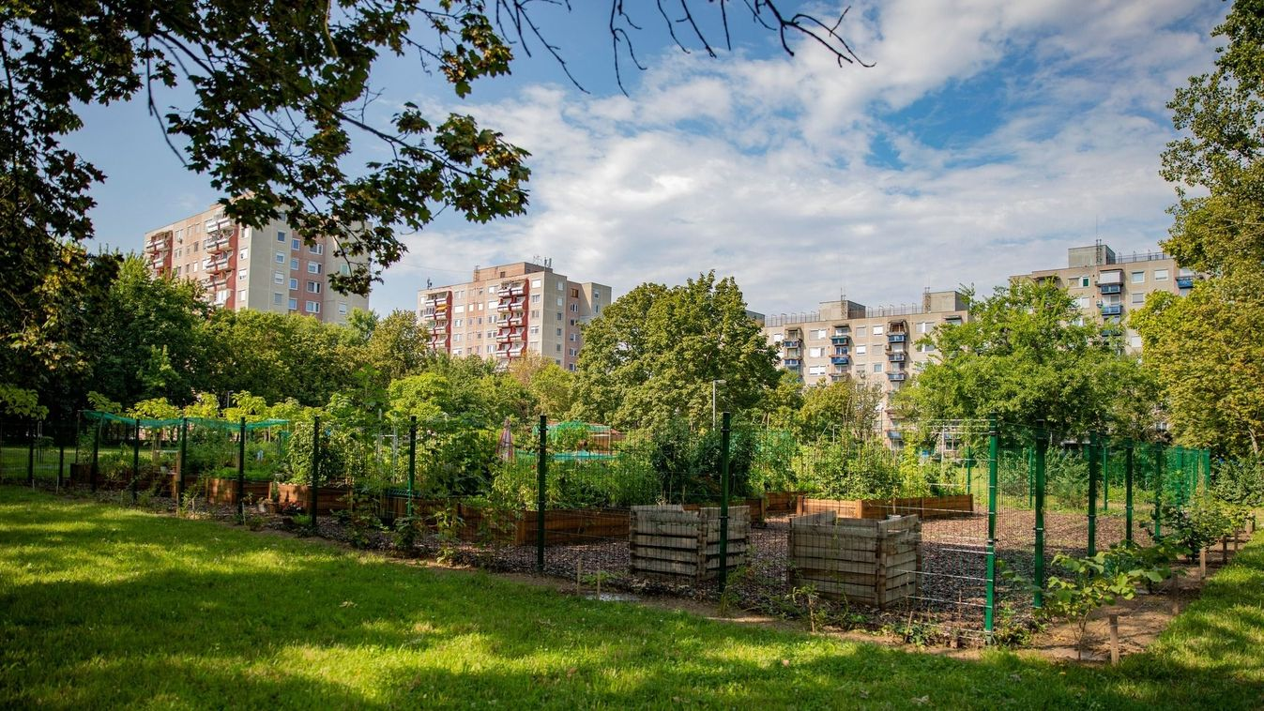
Sustainable collaborations

Slide 15
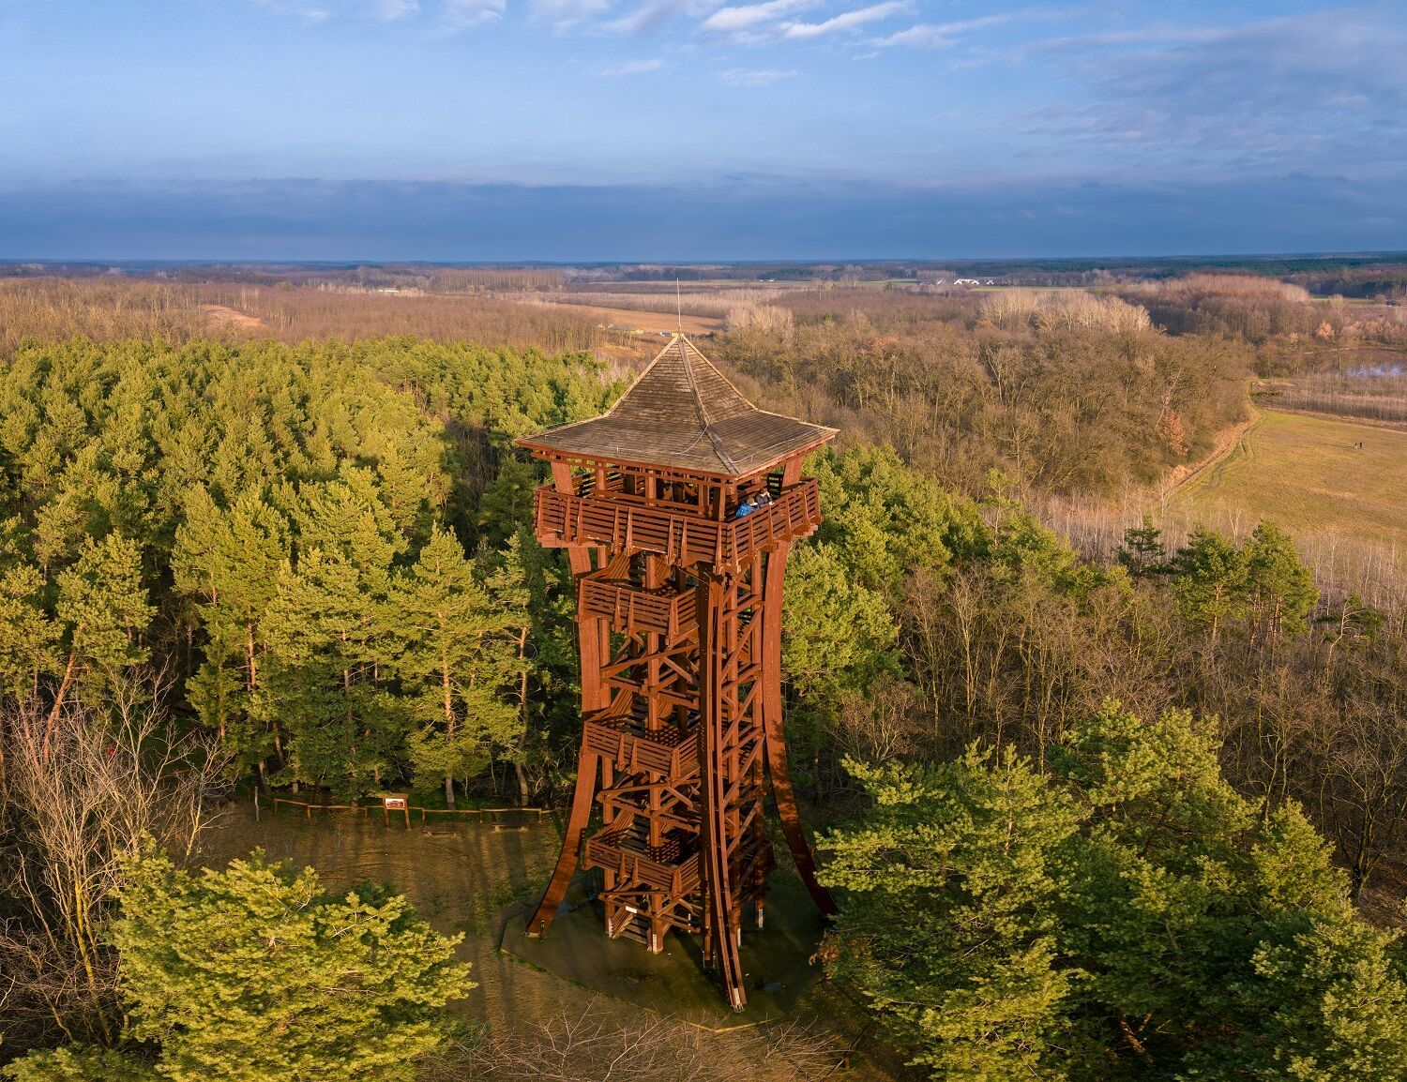
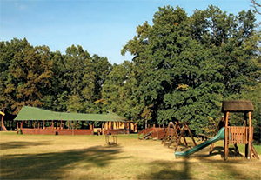
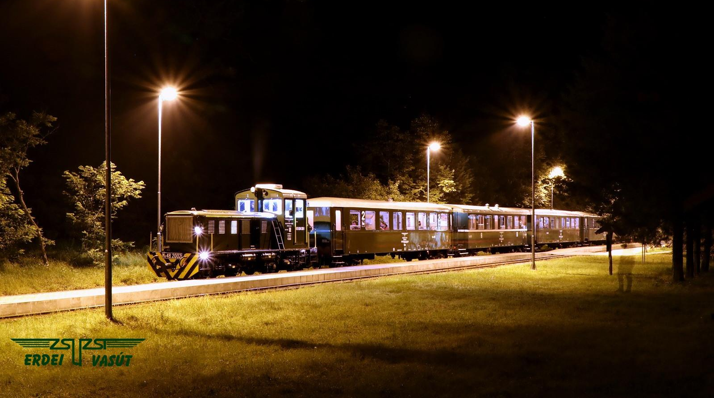
Sustainable collaborations

